Slide 1
Sources and ownership of monitoring and related data for Regional Haze planning analyses
Tom Moore (WESTAR and WRAP) and
Pat Brewer (NPS ARD)
for the Regional Haze Teach-In #2
July 27, 2017

Slide 2
Presentation Objective
Review pedigree of data from existing and planned data sources, explore transparency and consistency/comparability topics

Slide 3
Presentation outline
Data characteristics and needs
complete, transparent, reproducible, understandable
Data types – use and applications
monitoring, emissions, modeling
User levels
Analysts
Planners
Examples of displays and data

Slide 4
Glidepath and Regional Haze Planning
The Visibility Glidepath for the 20% worst visibility days at each Class I area is calculated as the straight line between the 5-year average visibility for baseline period 2000-2004 and estimated natural visibility conditions in 2064.
https://www.epa.gov/sites/production/files/2016-07/documents/technical_support_document_for_draft_guidance_on_regional_haze.pdf.

Slide 5
Glidepath and Regional Haze Planning
A regional photochemical model is used to project future visibility conditions at each Class I area in response to regional cumulative emissions in the future year.
2002 to 2018 – round 1 of RH SIPs
2014 or 2016 to 2028 – round 2 of RH SIPs, due in July 2021
To get the future visibility projection value, the ratio of visibility modeling results at each Class I area for the base and future years are “adjusted” by the most recent 5-year historical monitoring data average - this is called the “Relative Response Factor”.
This modeled and adjusted future visibility value is compared to the uniform rate of progress glidepath at the point where it intersects 2028.
The future year visibility projection values can be tested multiple times by re-running the future year model with different emissions inputs.

Slide 6
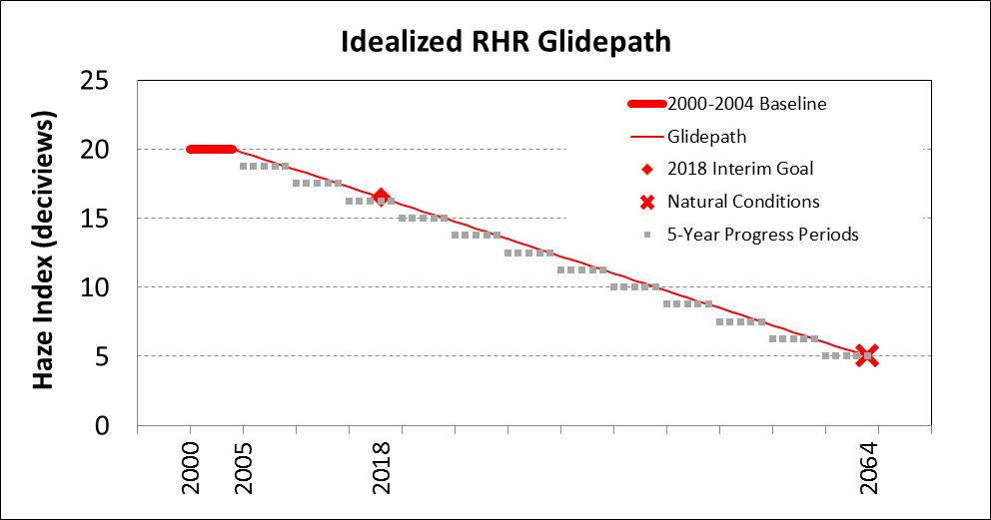
Regional Modeling-based Visibility Projection values fall below glidepath
(Measured)
(Estimated)
(Estimated)
(Measured)
Modeled projections
Modeled glidepath
Estimated Natural Conditions
2028

Slide 7
Regional Modeling-based Visibility Projection values fall above glidepath
(Measured)
(Estimated)
(Estimated)
(Measured)
Modeled projections
Modeled glidepath
Estimated Natural Conditions
2028

Slide 8
New data for the glidepath: Most Impaired Days
In the second implementation period, EPA has proposed a receptor-based statistical method to apportion IMPROVE aerosol extinction to natural or anthropogenic sources using chemical species as proxies for source types.
Based on selecting the poor visibility days differently than Round 1, the proposed Round 2 glidepaths now illustrate the uniform rate of progress on the average 20% most impaired days
Statistical methods have been used to revise existing IMPROVE data back through the baseline 2000-2004 period as well as extending to newly revised estimates of natural conditions.

Slide 9
New data for the glidepath: Most Impaired Days
States are to model future visibility in response to regional cumulative emissions.
As in Round 1, modeled future visibility projections will be compared to the uniform rate of progress
Modeled source apportionment is emissions-based and projects atmospheric chemistry transport and aerosol mass and composition at the monitor.
The receptor-based and emissions-based methods of apportionment to natural and anthropogenic sources are not necessarily equivalent.
At small aerosol concentrations (common in WESTAR and WRAP region Class I areas), small differences between model and monitor can lead to large % differences between methods
Currently evaluating model and observation-based apportionment methods and implications for glidepath and progress to natural conditions.
Significant challenges remain for implementing the Most Impaired Days metric:
To accurately or precisely understand these “method changes” in terms of emissions,
Expect the modeling to respond, and/or
To explain how we “know them to be correct”

Slide 10
Haziest days and most impaired days:
Same days in the East
Different days, different
pollutants in the West

Slide 11
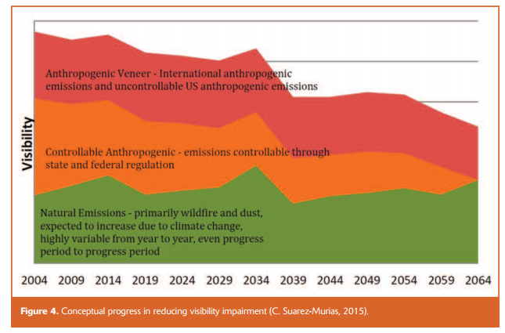
Emissions types and factors affecting chemical species used to track Regional Haze
Anthropogenic reduction due to
technology change
through
Adapted from:

Slide 12
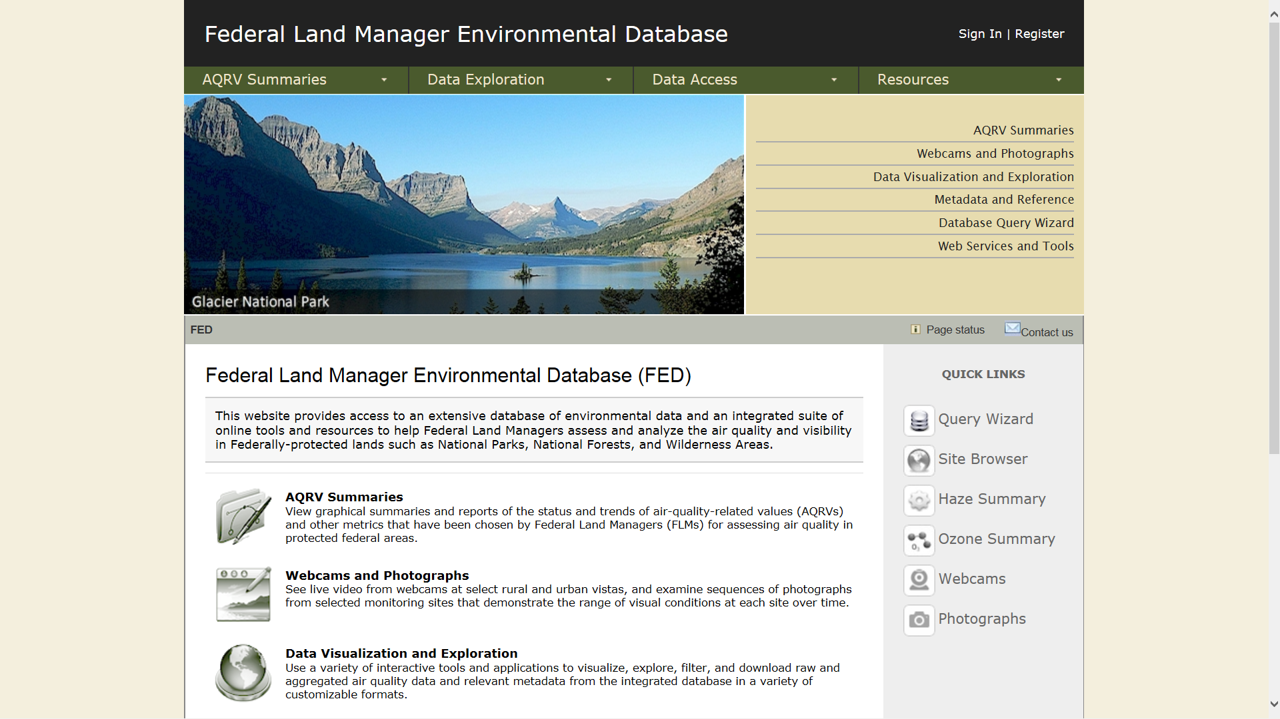
User levels
Analysts
FED http://views.cira.colostate.edu/fed/
Very detailed
Fundamental data source
Directed by federal agencies
Not intended for planning
Challenges with ease of reproducing results between many users.

Slide 13
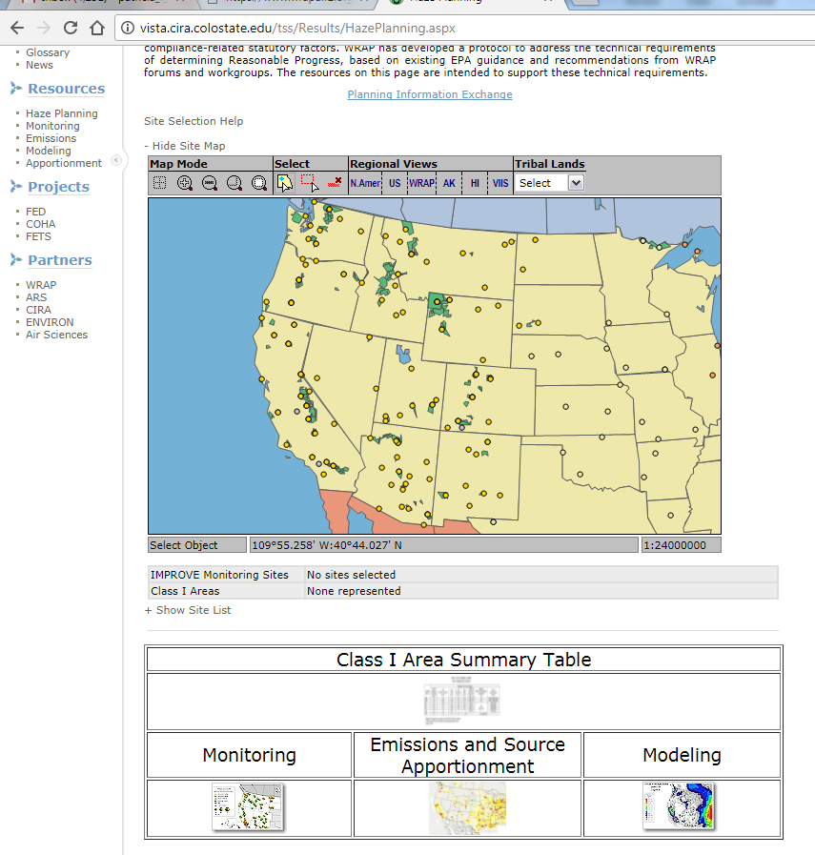
User levels
Planners
WRAP Technical Support System (TSS) http://vista.cira.colostate.edu/TSS/
Designed to provide planning data (monitoring, emissions modeling, source apportionment) specifically required for Regional Haze SIPs
Runs on same database as FED
Functions as technical support documentation for all regional analyses
Directed by WRAP members – states, feds, tribes, local air agencies
Reports vetted and approved data summarized at appropriate levels for RHR SIPs
TSS v2 - 2018
Will be updated as overseen by WRAP members to report new data
To be formatted to revised RHR requirements and planning metrics decided for use in 2028 plans
Also will include other regional air quality analyses - ozone, N dep, tribal impacts, et cetera

Slide 14
Regional Haze Planning – Example graphics

Slide 15
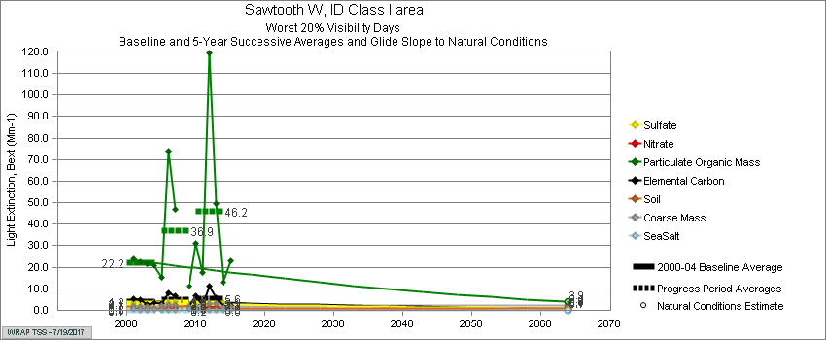
Difficult to demonstrate benefits of reducing US anthropogenic emissions when haziest days are dominated by carbon from wildfire
Sawtooth (ID) Visibility Progress by Species

Slide 16
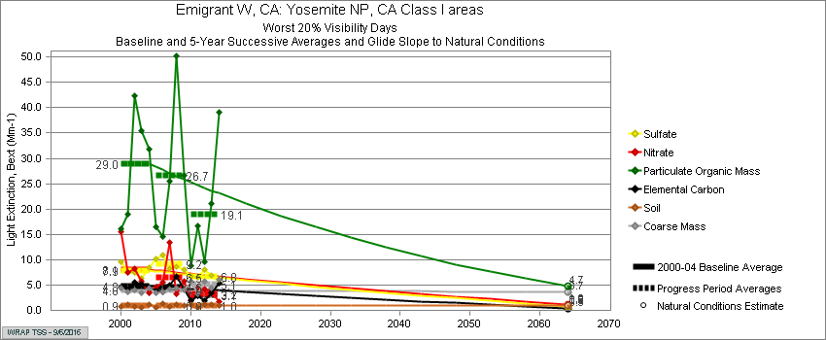
Yosemite (CA) Visibility Progress by Species
SO4
NO3
POM
EC
Soil
Coarse

Slide 17
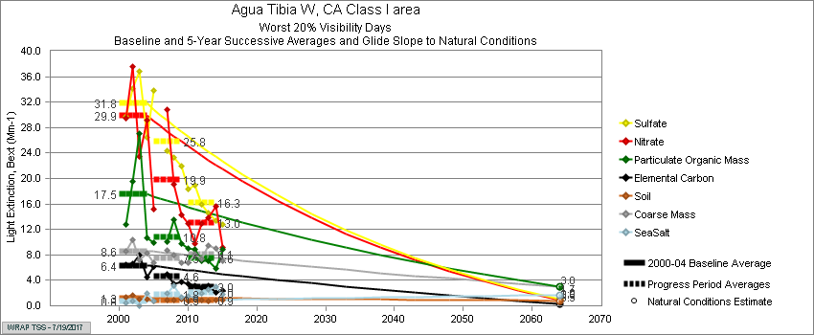
Speciated glidepath graphics were unique products of WRAP TSS;
western states may want to define specific products for second planning period
Aqua Tibia (CA) Visibility Progress by Species

Slide 18
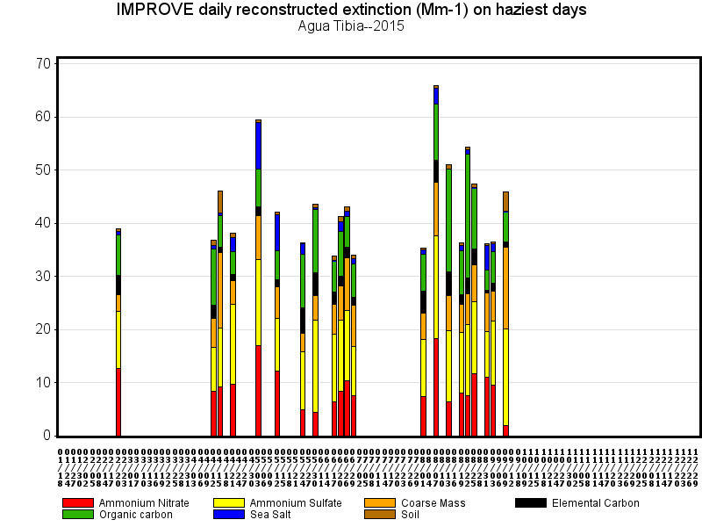
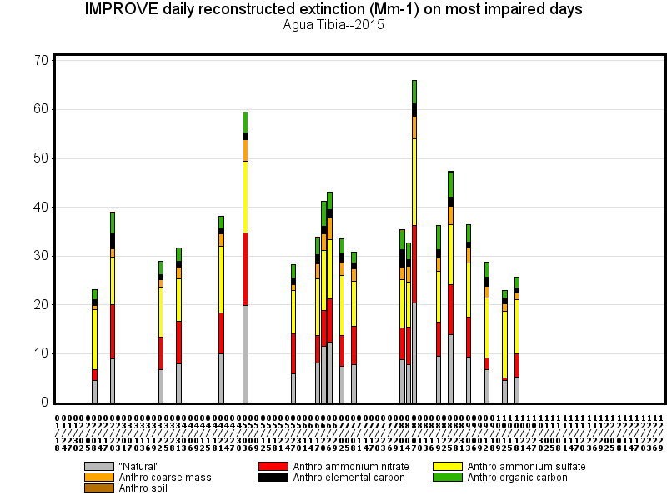

Slide 19
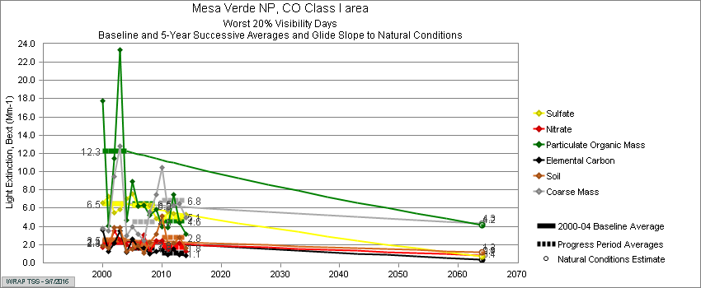
Mesa Verde (CO) Visibility Progress
SO4
NO3
POM
EC
Soil
Coarse

Slide 20
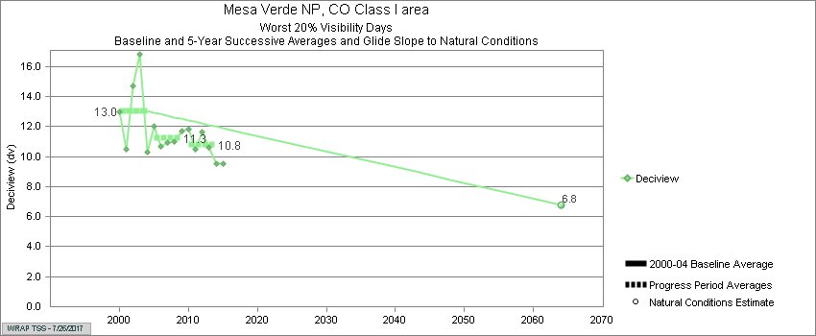
Mesa Verde (CO) Visibility Progress
SO4
NO3
POM
EC
Soil
Coarse
Within 4 dv of natural conditions on worst days

Slide 21
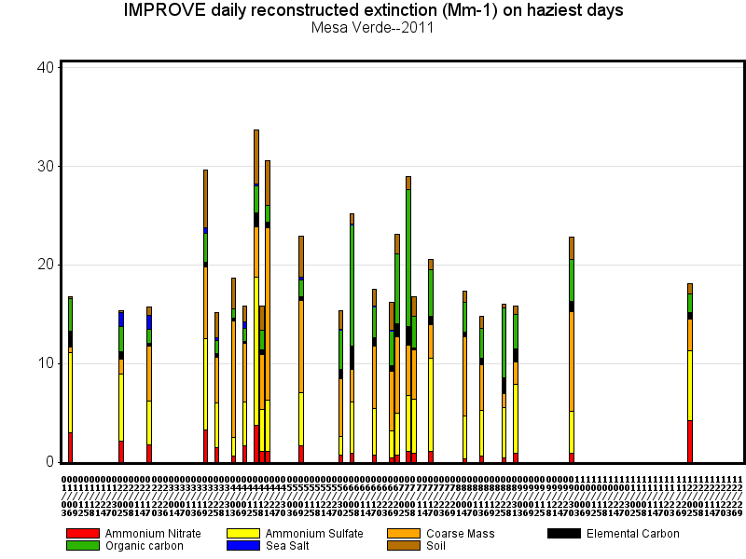
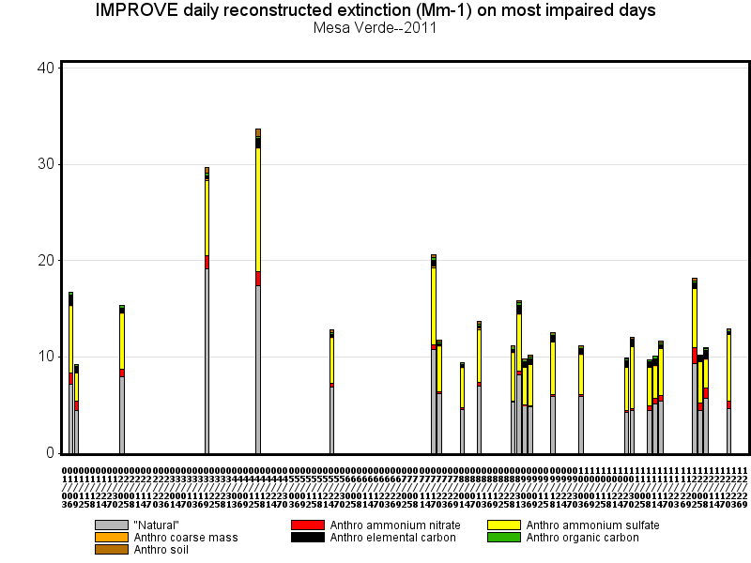

Slide 22
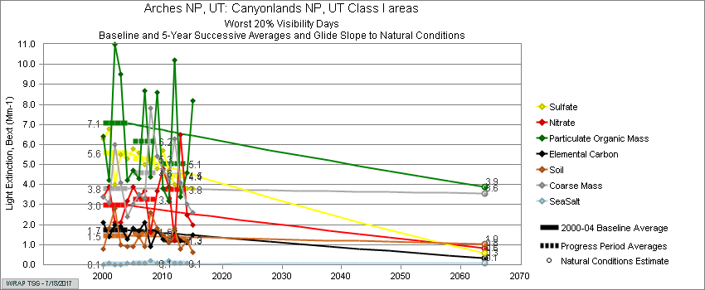
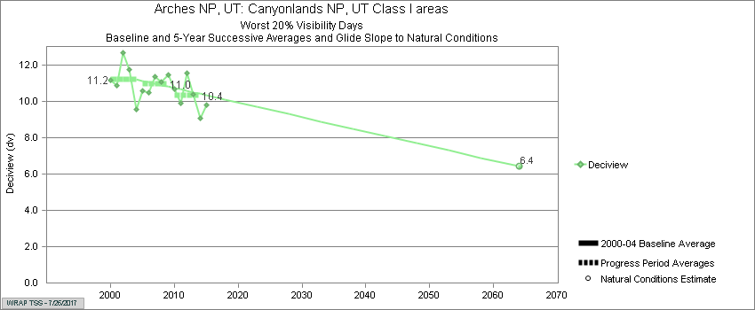
Canyonlands (UT) Visibility Progress by Species
Within 4 dv of natural conditions on worst days

Slide 23
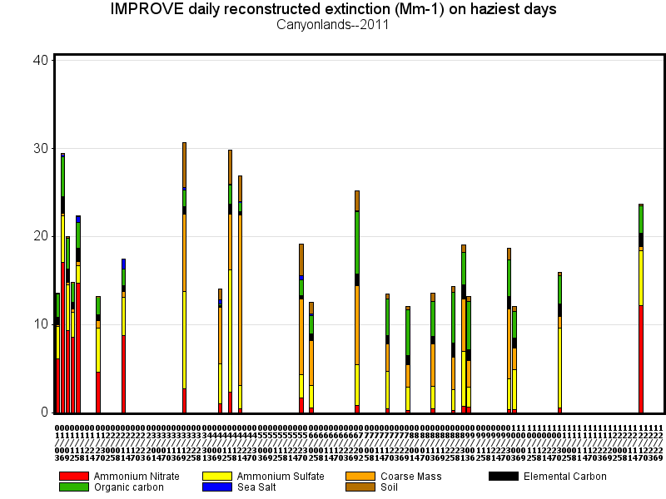
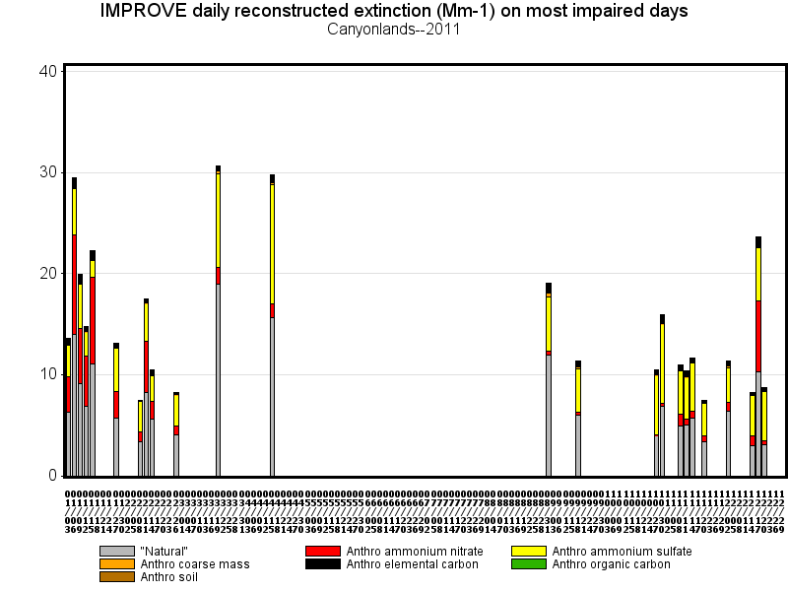

Slide 24
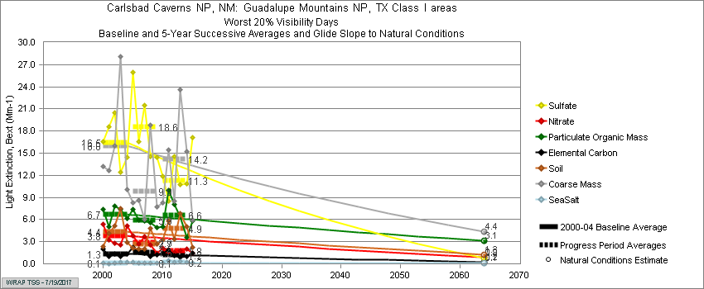
Guadalupe Mtns. (TX) Visibility Progress by Species

Slide 25
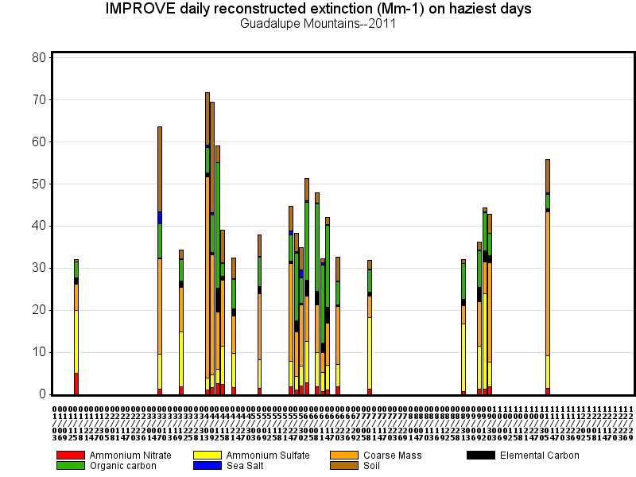
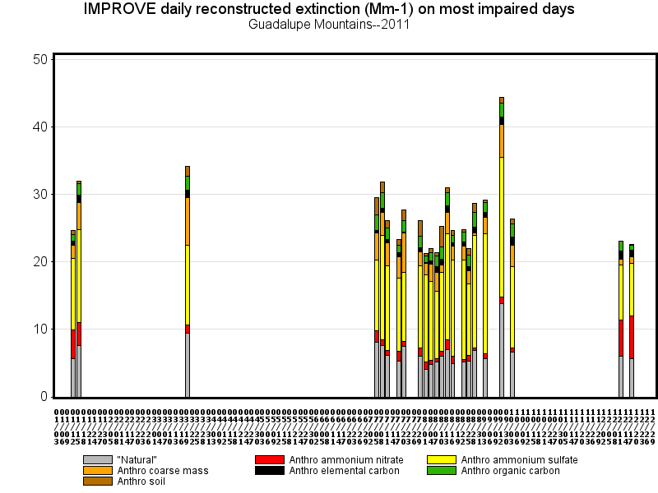

Slide 26
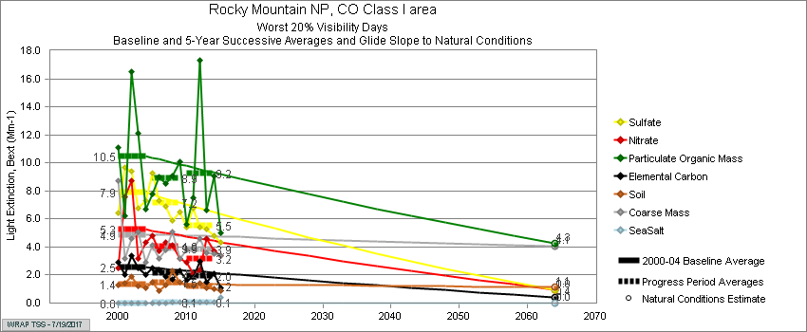
Rocky Mountain (CO) Visibility Progress by Species

Slide 27
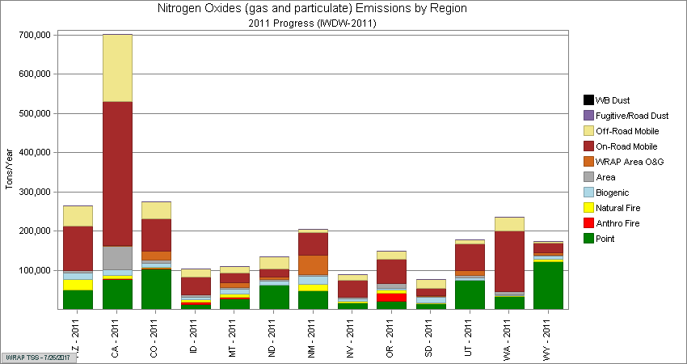
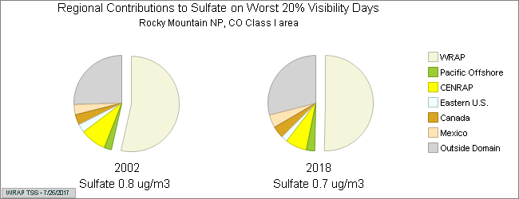
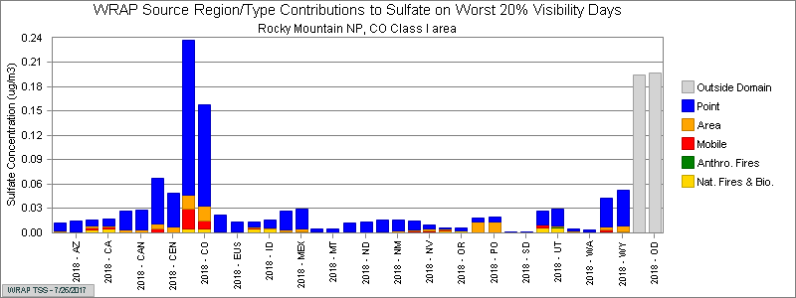
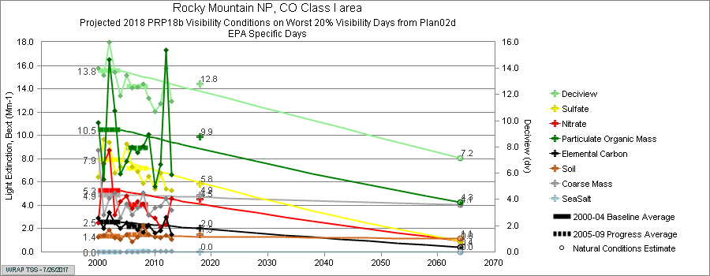
Emissions used in regional modeling
Source apportionment from regional modeling
Emissions Data, Modeling and Source Apportionment Results, and Monitoring Data by Class I area
Visibility projections with monitoring data and estimated natural conditions

